Slide 1
Twitter, HealthKit, and Firebase

Slide 2
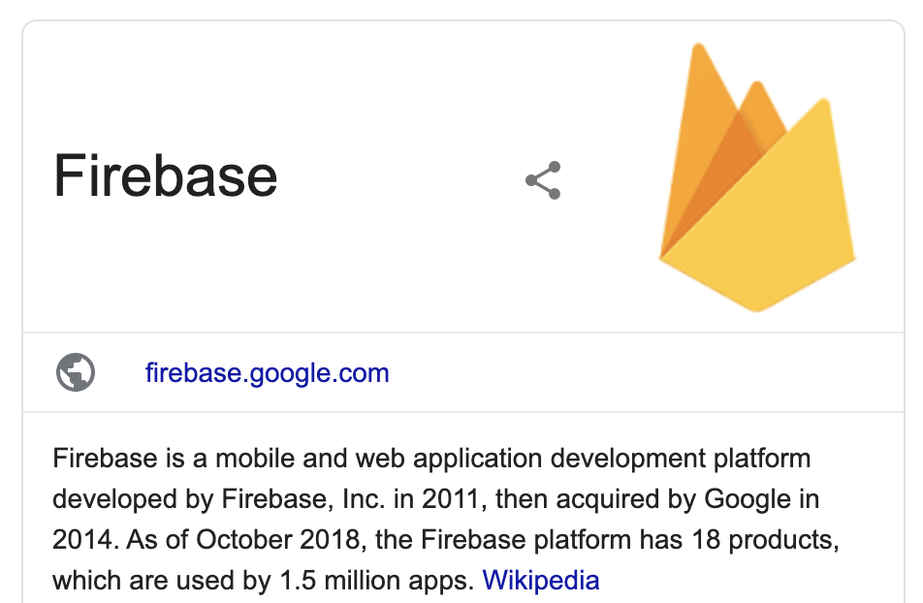
Twitter and Firebase
authenticate
health information
CordovaHealth
authenticate
authenticate
health information
Your App GUI
rq. tweets
codebird.js (consumer keys + cors)
rp. tweets
Access token, secret
rp. tweets
rq. tweets
rq. tweets
Twitter Feed Service (Node.js)
rp. tweets

Slide 3
Resources
Firebase developer
https://console.firebase.google.com
Twitter developer
https://developer.twitter.com
Firebase + Twitter login
https://firebase.google.com/docs/auth/web/twitter-login
Node.js server to load tweets
https://www.sitepoint.com/building-twitter-app-using-angular
Cordova Plugin Health
https://www.npmjs.com/package/cordova-plugin-health
Working with firebase database
https://firebase.google.com/docs/database/web/start
Security rules
https://firebase.google.com/docs/firestore/security/get-started
Codebird
https://github.com/jublo/codebird-js

Slide 4
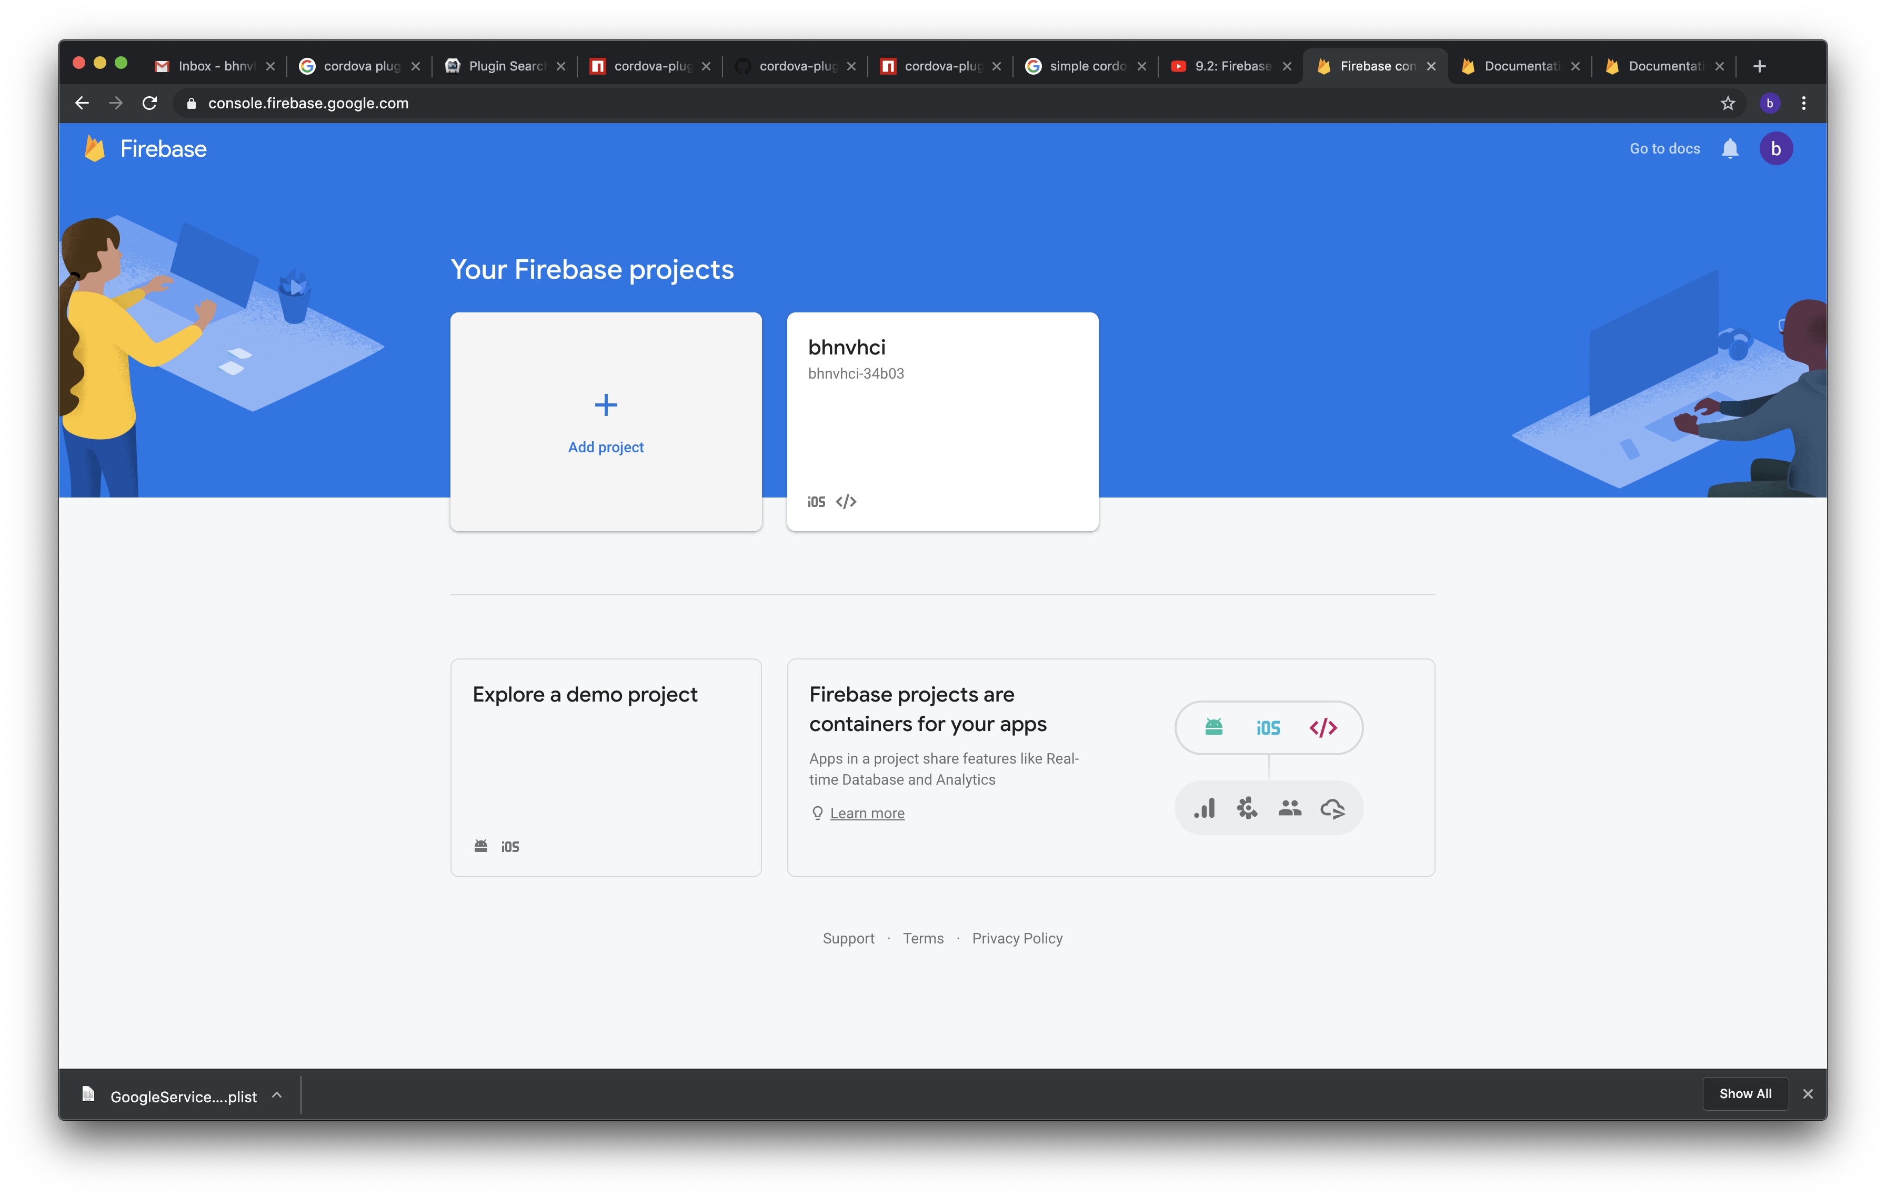

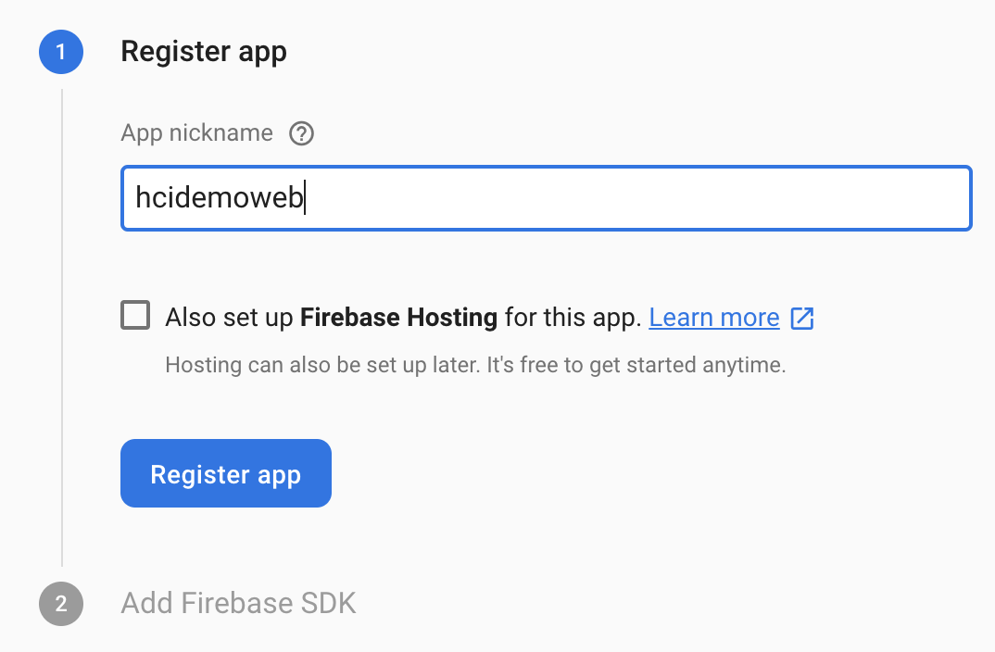
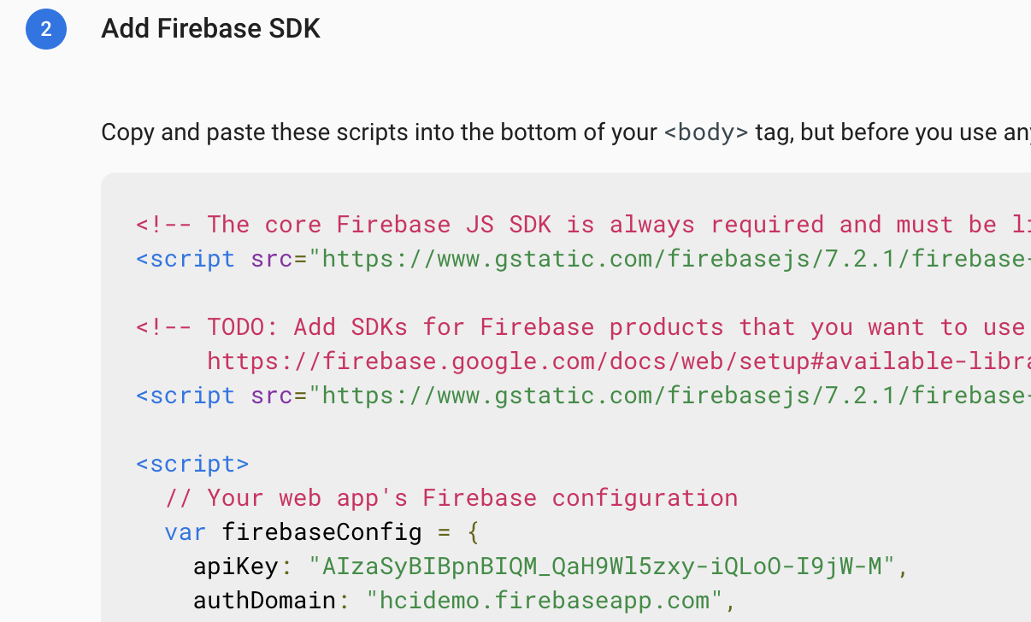

Setting up firebase project (hcidemoweb)
Copy these lines of code to your web app

Slide 5
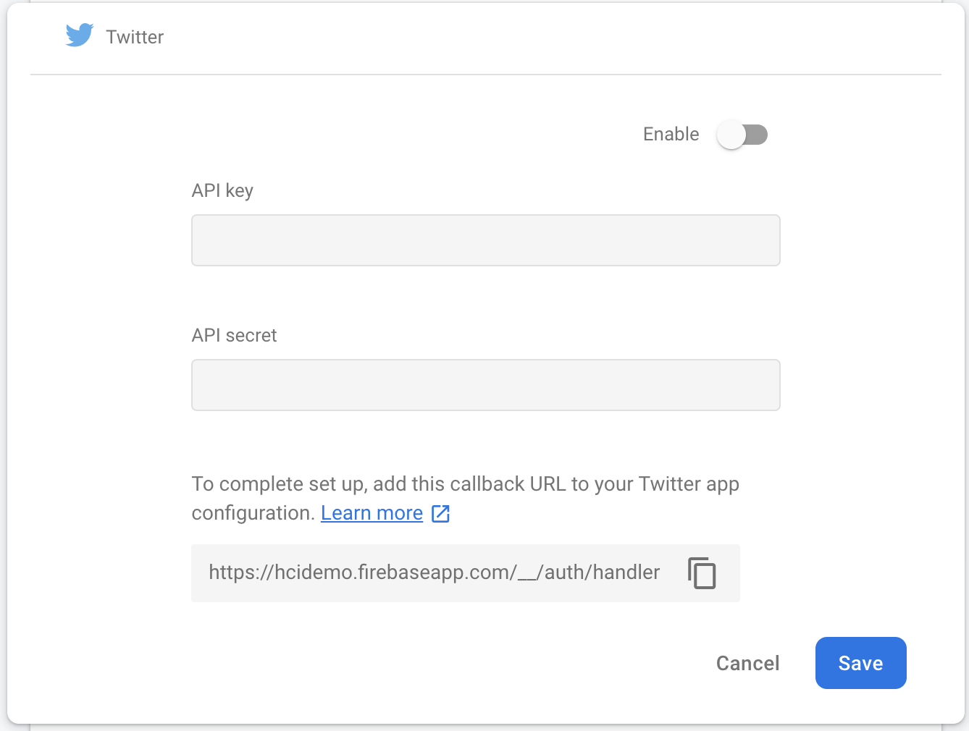
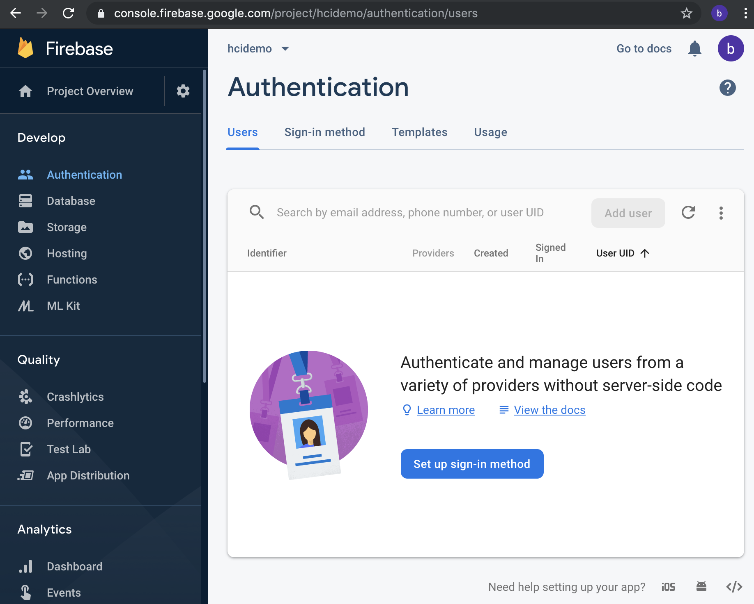
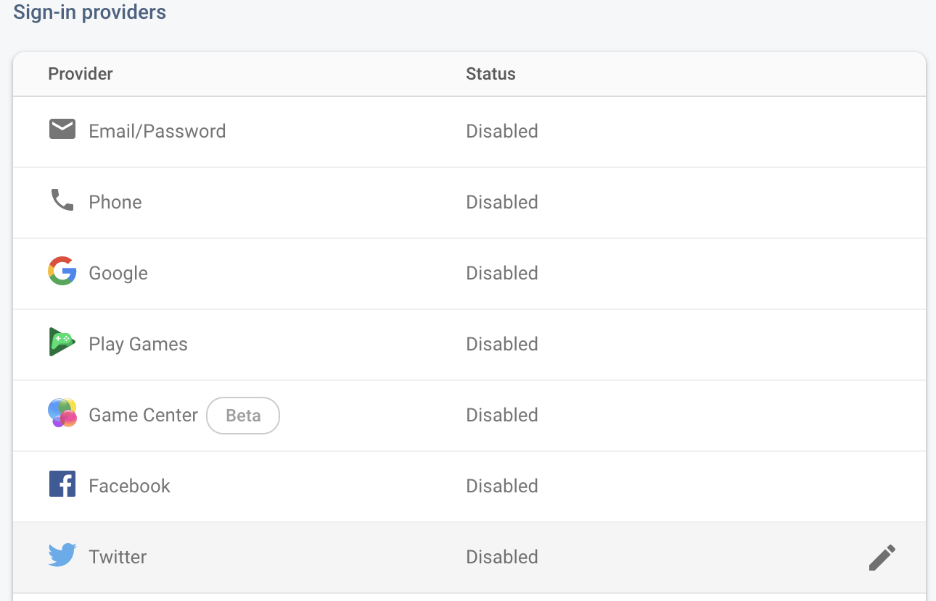
Add Twitter authentication
Copy this link

Slide 6
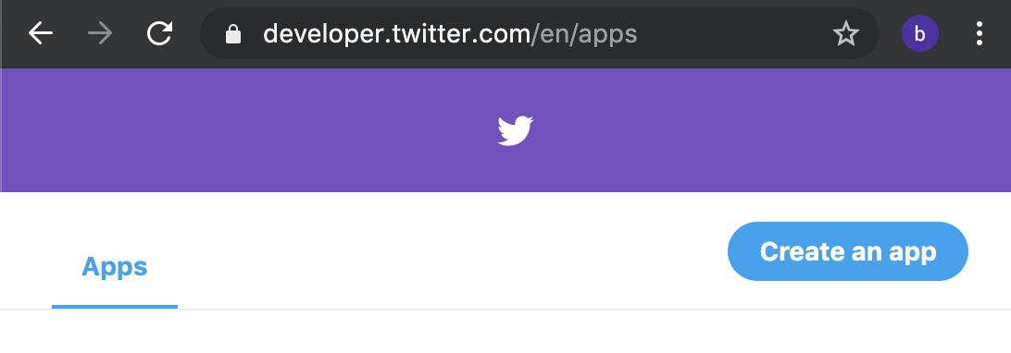
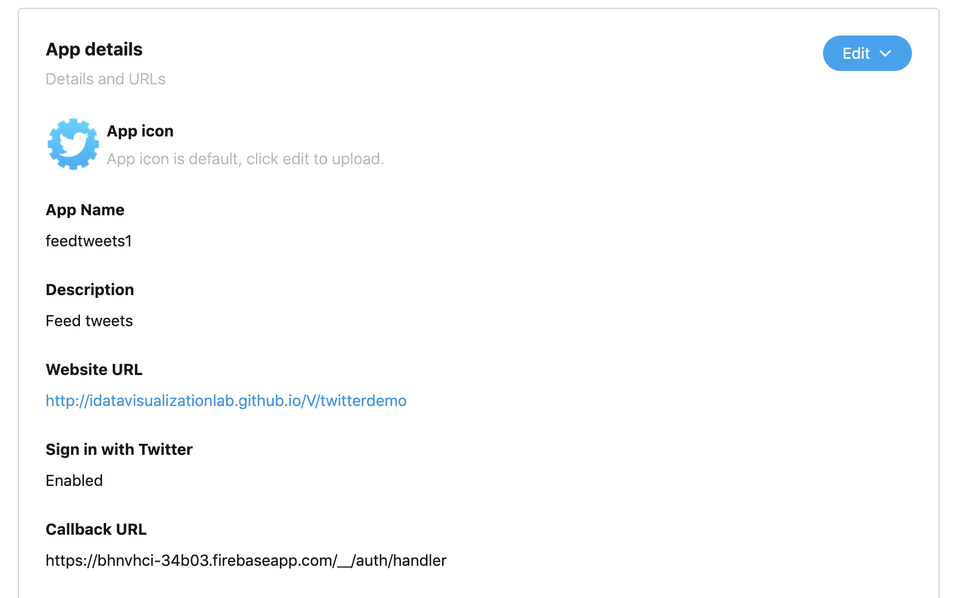
Twitter app (twitter developer account)
Paste the link from previous step here

Slide 7
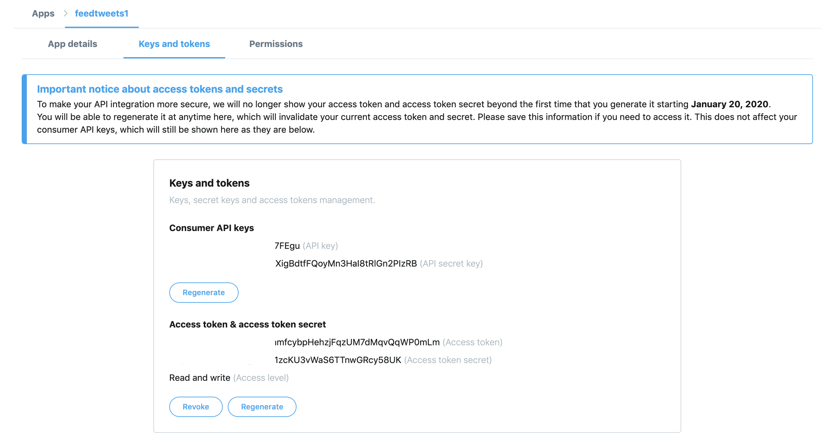

Generate keys
Copy these two for the next few steps
(These are consumer keys)
Copy these two for the next few steps
(These are user keys)

Slide 8
Continue from firebase Twitter auth. config
Enable twitter authentication
Paste the prev. two keys here

Slide 9
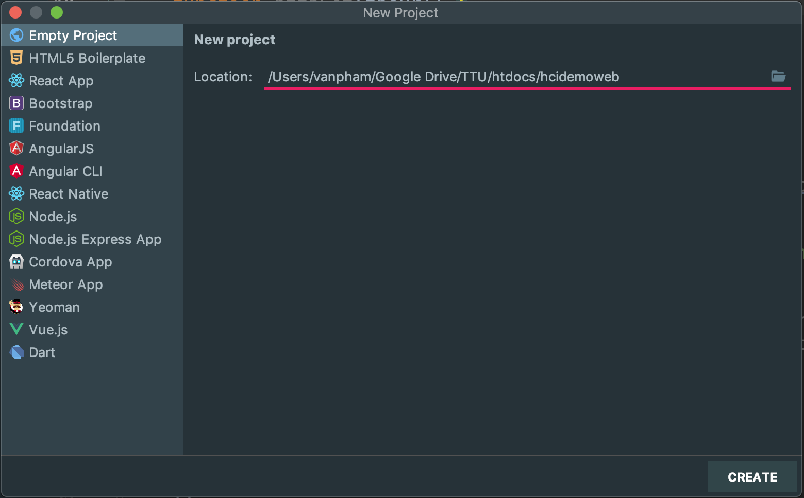
Create a new web application

Slide 10
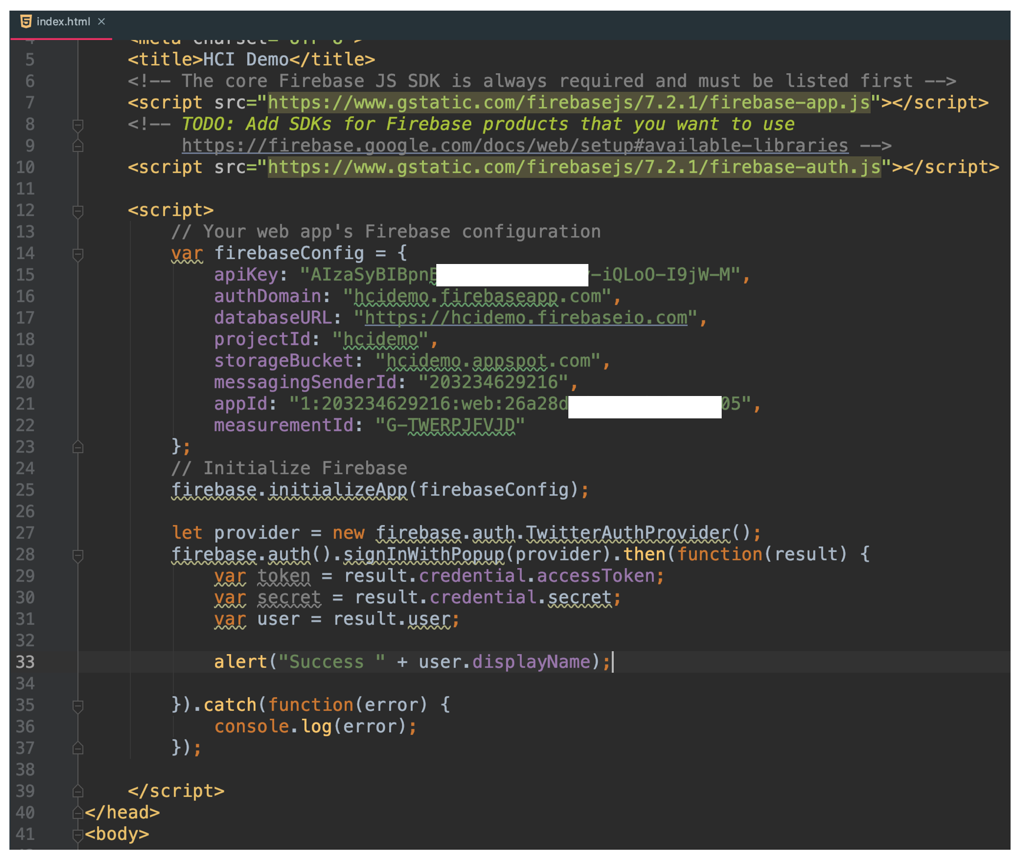

Add scripts
Code from “Setting up firebase project” step
Add these for authentication

Slide 11
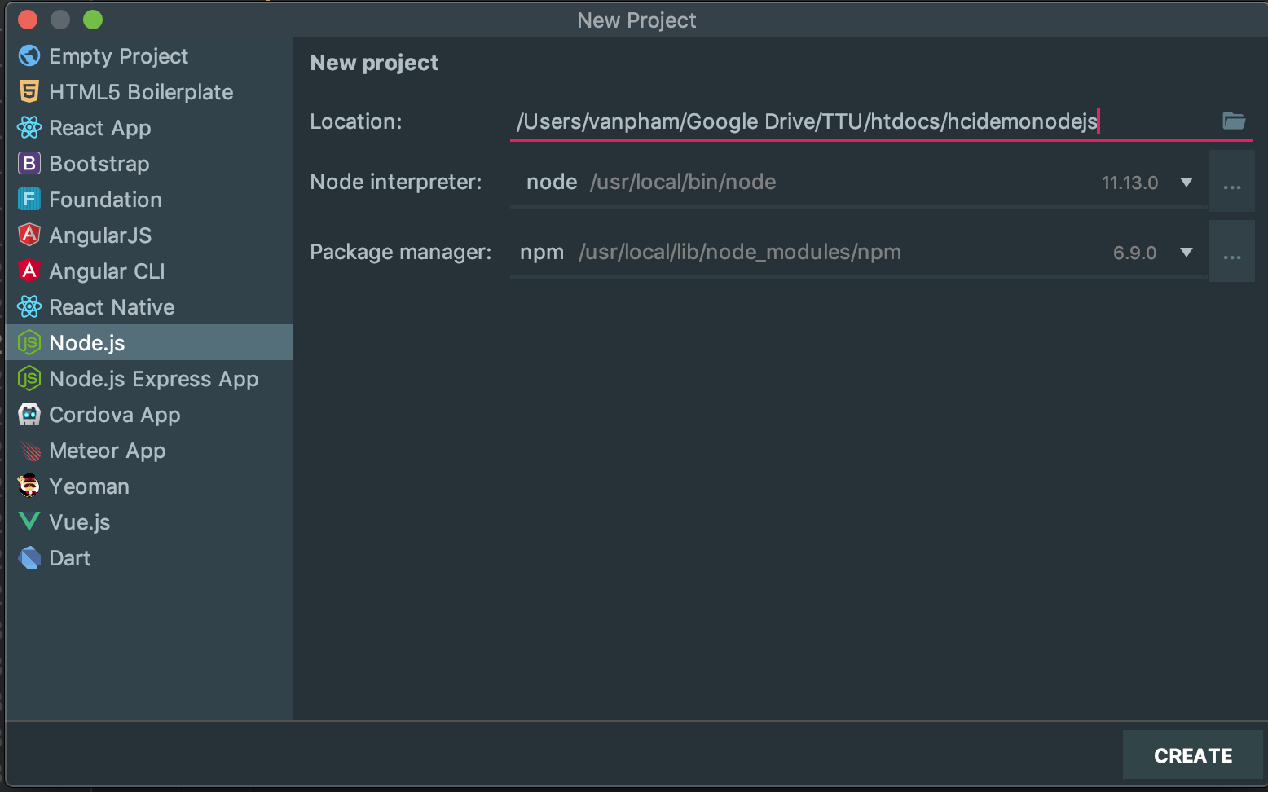
Node.js server to feed tweets (hcidemonodejs)

Slide 12
Add plugins
Go to your node project and add the following packages
npm install --save express
npm install --save twit
npm install --save cors

Slide 13
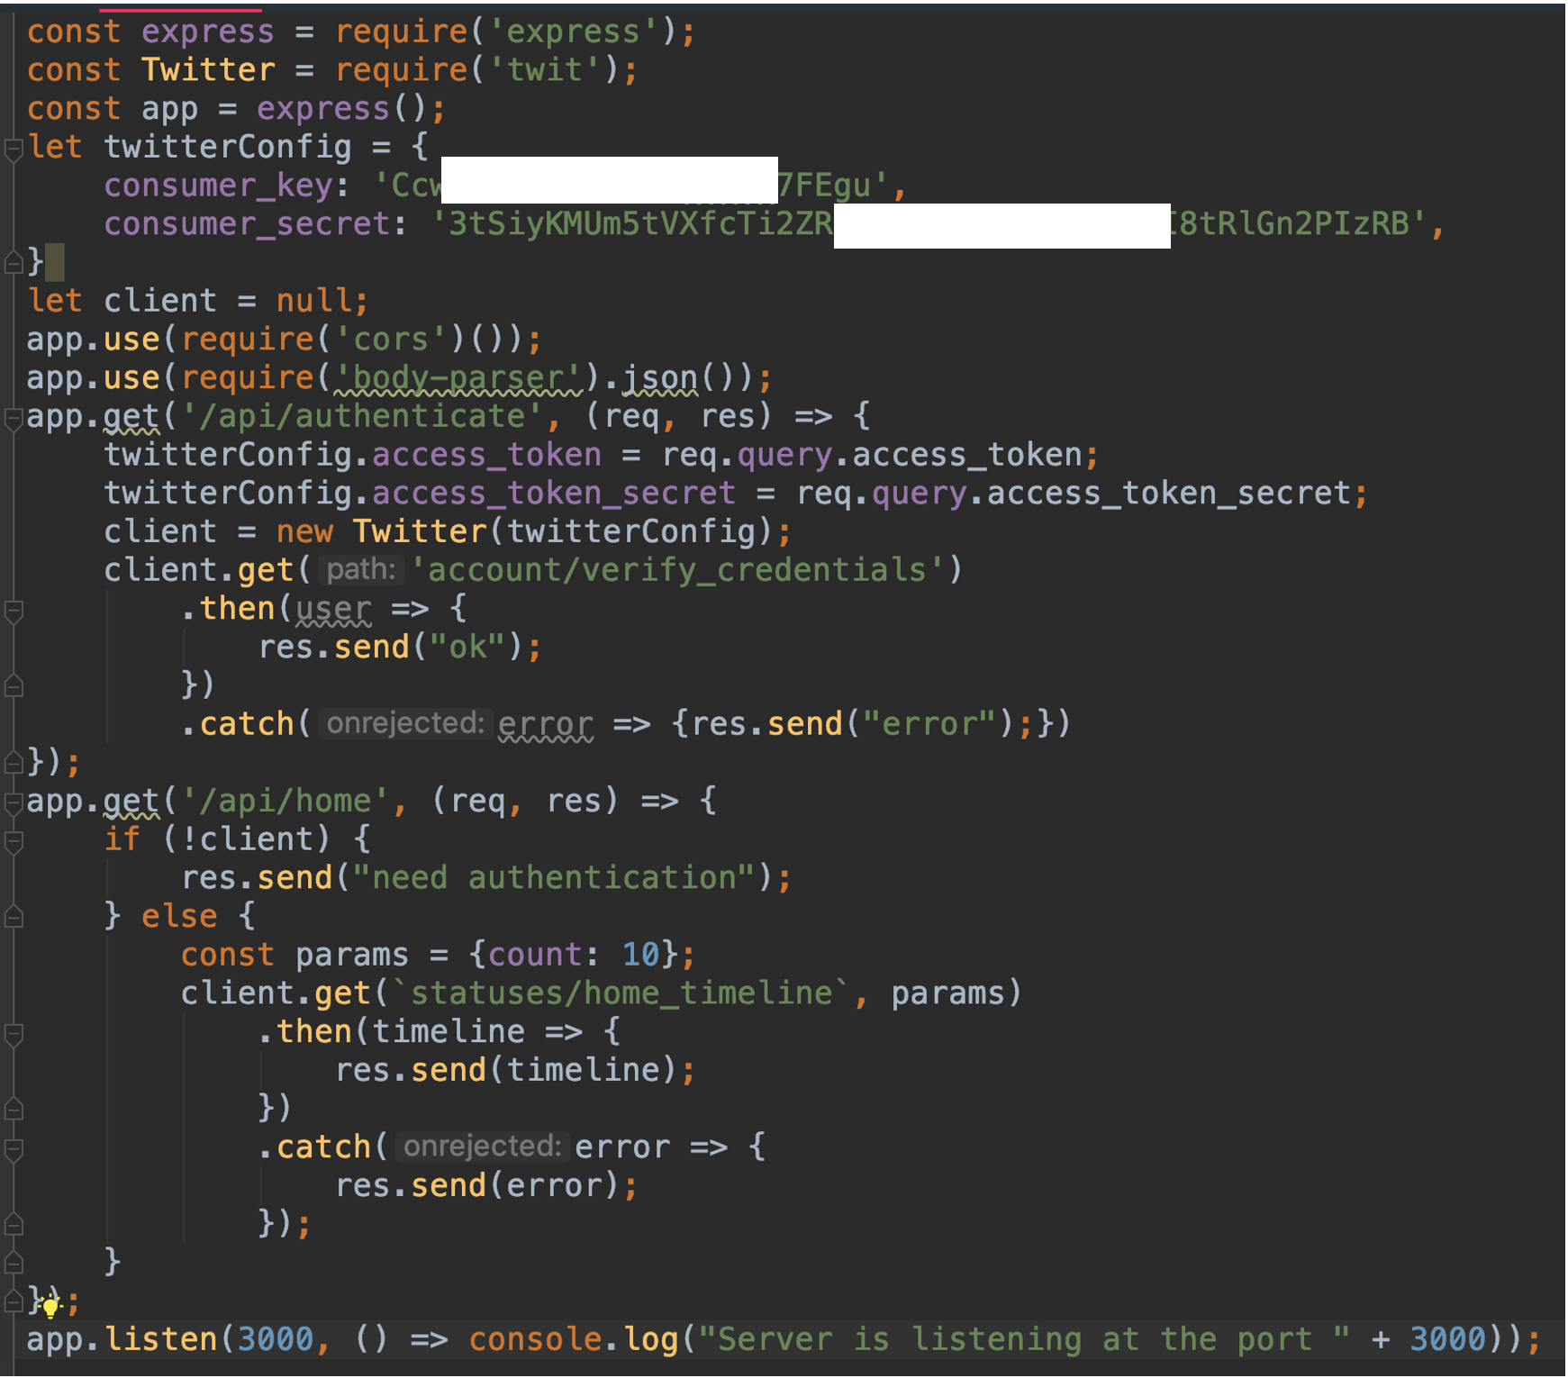

server.js code
Twitter consumer keys
Loading tweets from time-line
Serve at this port

Slide 14
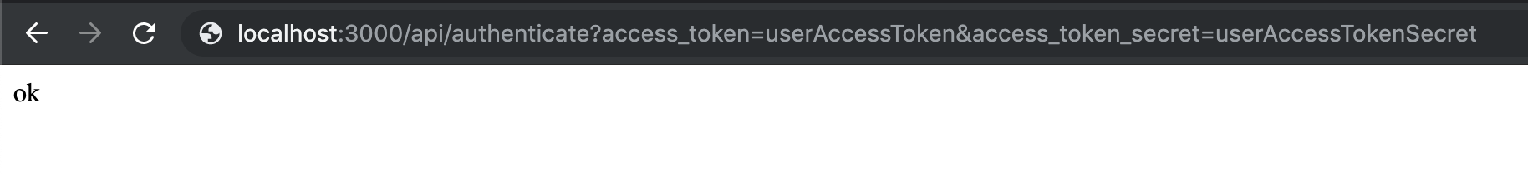
Test
Twitter user’s keys (from prev. step)

Slide 15
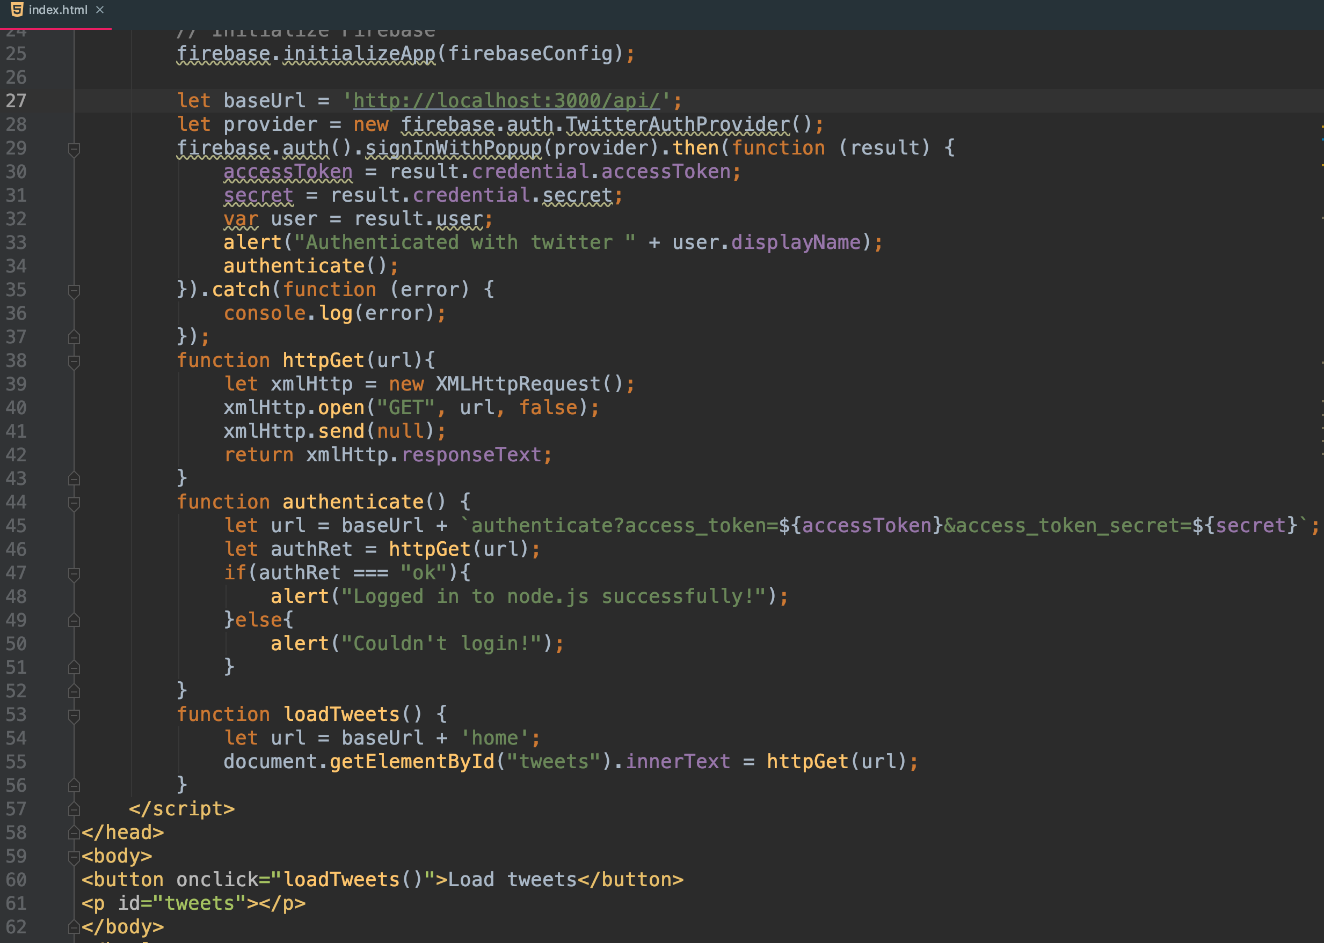
Update index.html (from hcidemoweb)
Base service URL
Authenticate to node.js server
Utility functions
Load the tweets

Slide 16
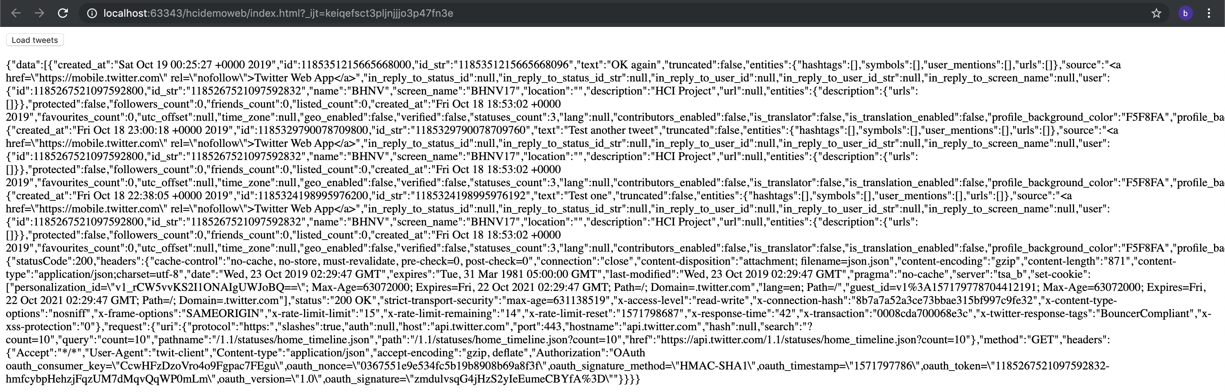
Test it
Run command: node server.js to start hcidemonodejs server
Run our website (hcidemoweb) and allows pop-up for Twitter authentication

Slide 17
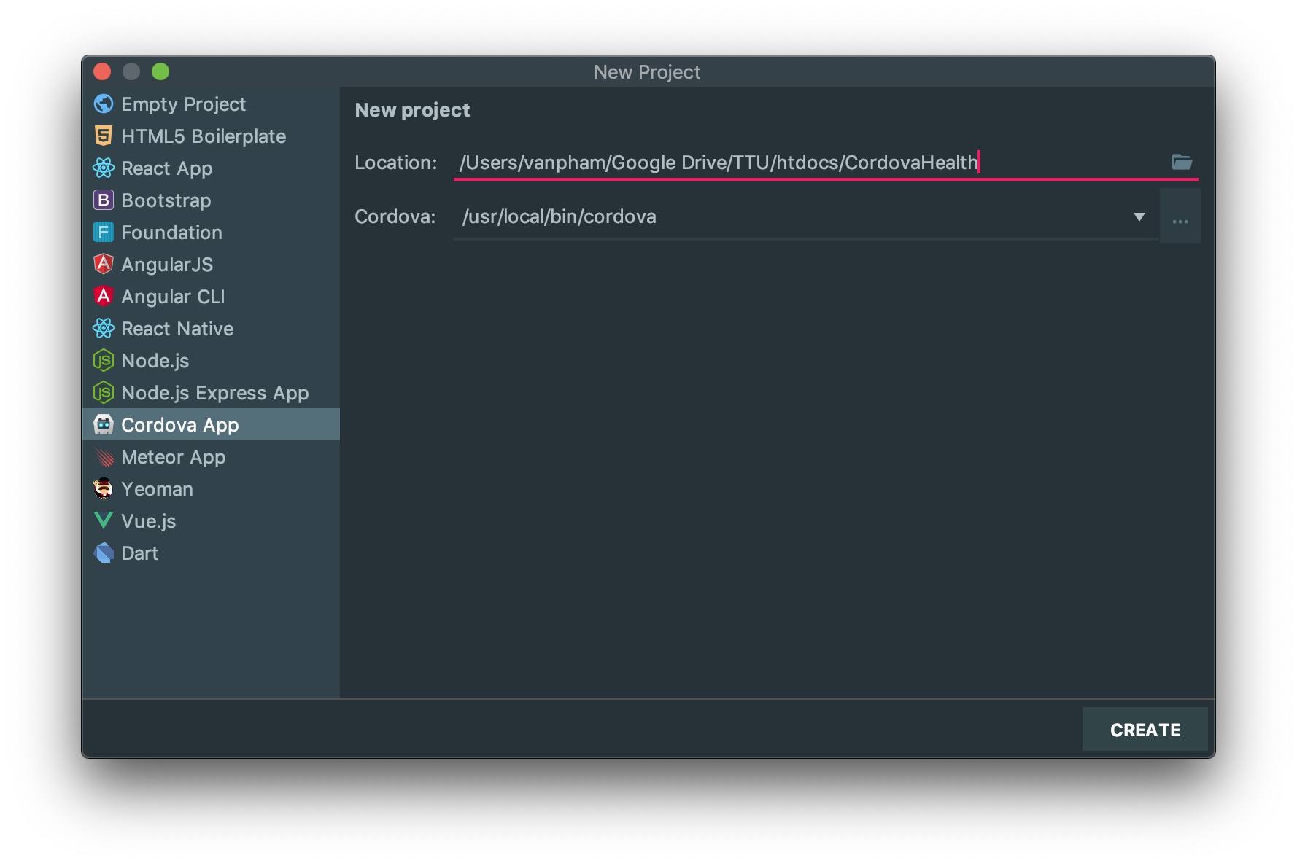
New Cordova App to access Health Inf.

Slide 18
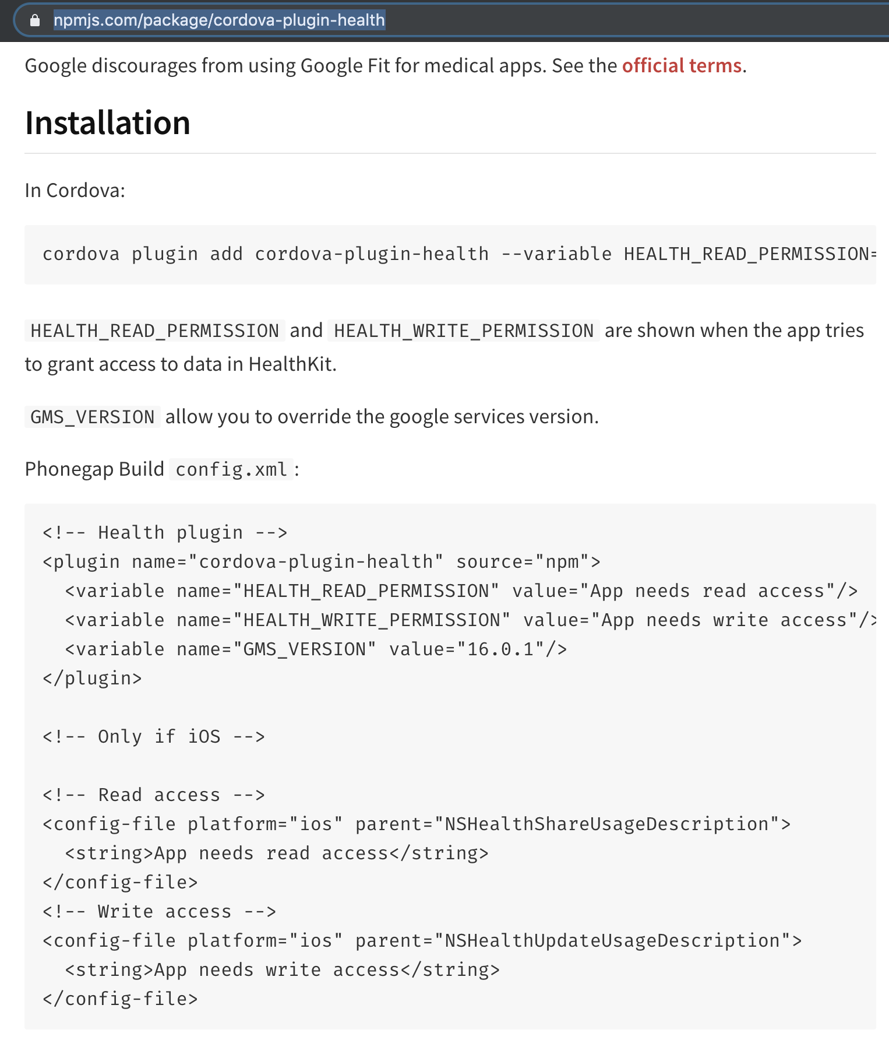
Add Cordova plugin (https://www.npmjs.com/package/cordova-plugin-health)
Install plugin
Add these to config.xml

Slide 19
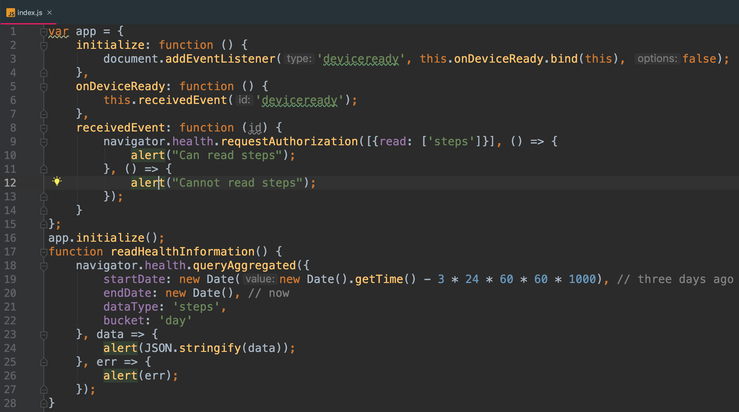
Change index.js
Request authorization
Read health info

Slide 20
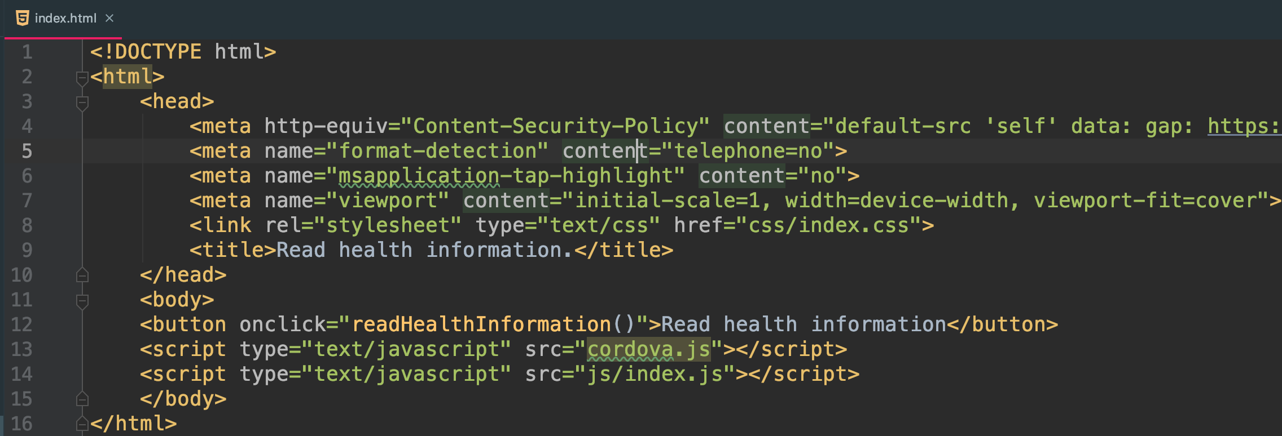
Change index.html
Add this line to load health information
Comment this line out if onclick event of the button doesn’t work

Slide 21
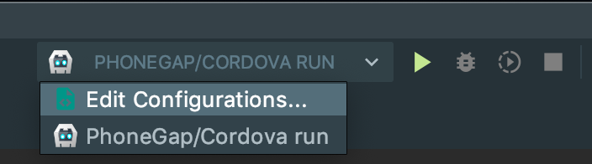
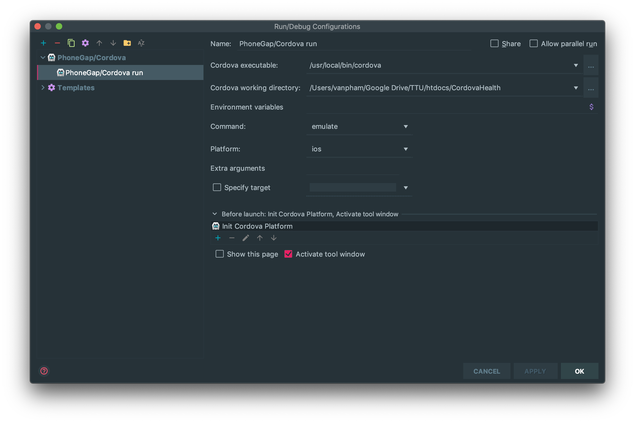
Add iOS run configuration

Slide 22
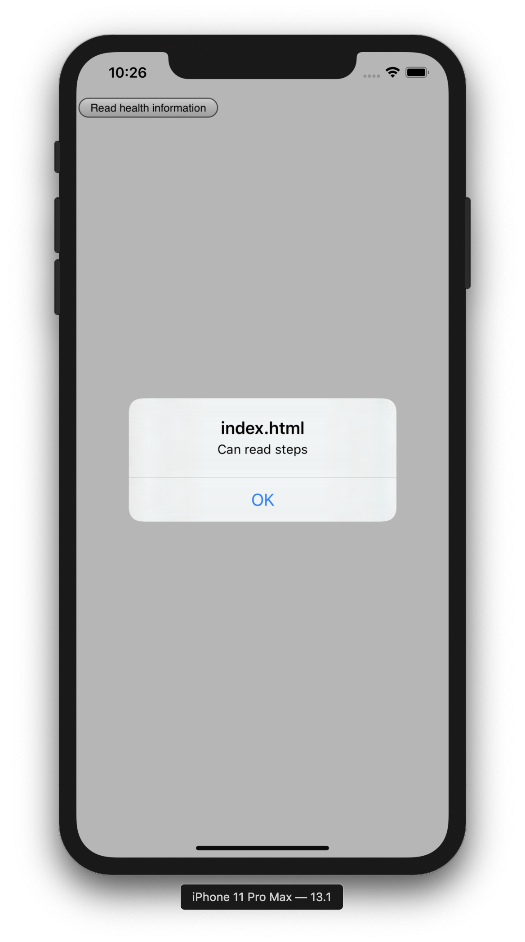
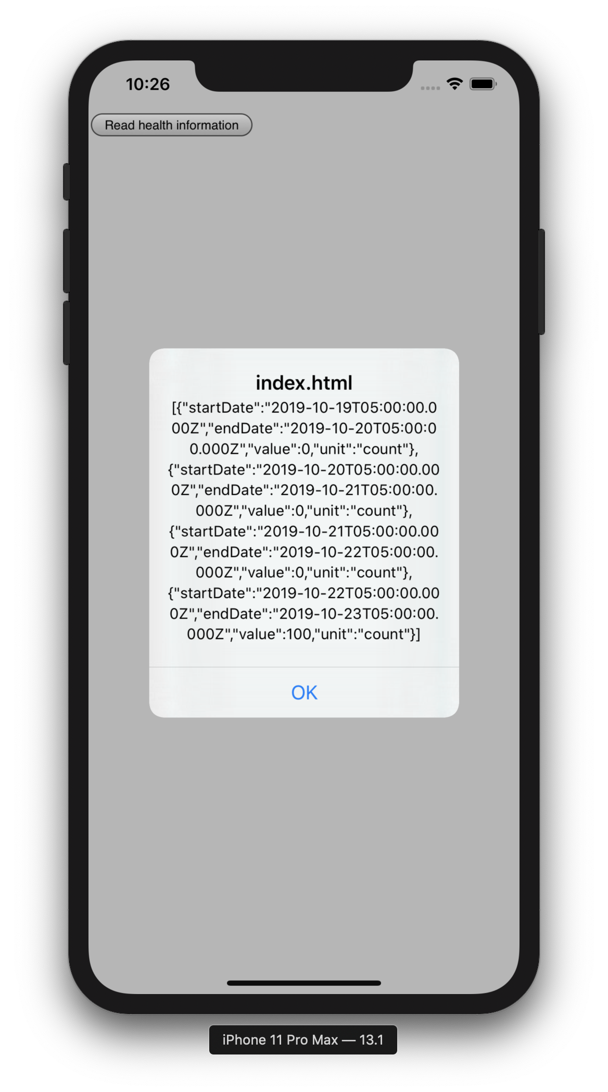
Read the health information

Slide 23
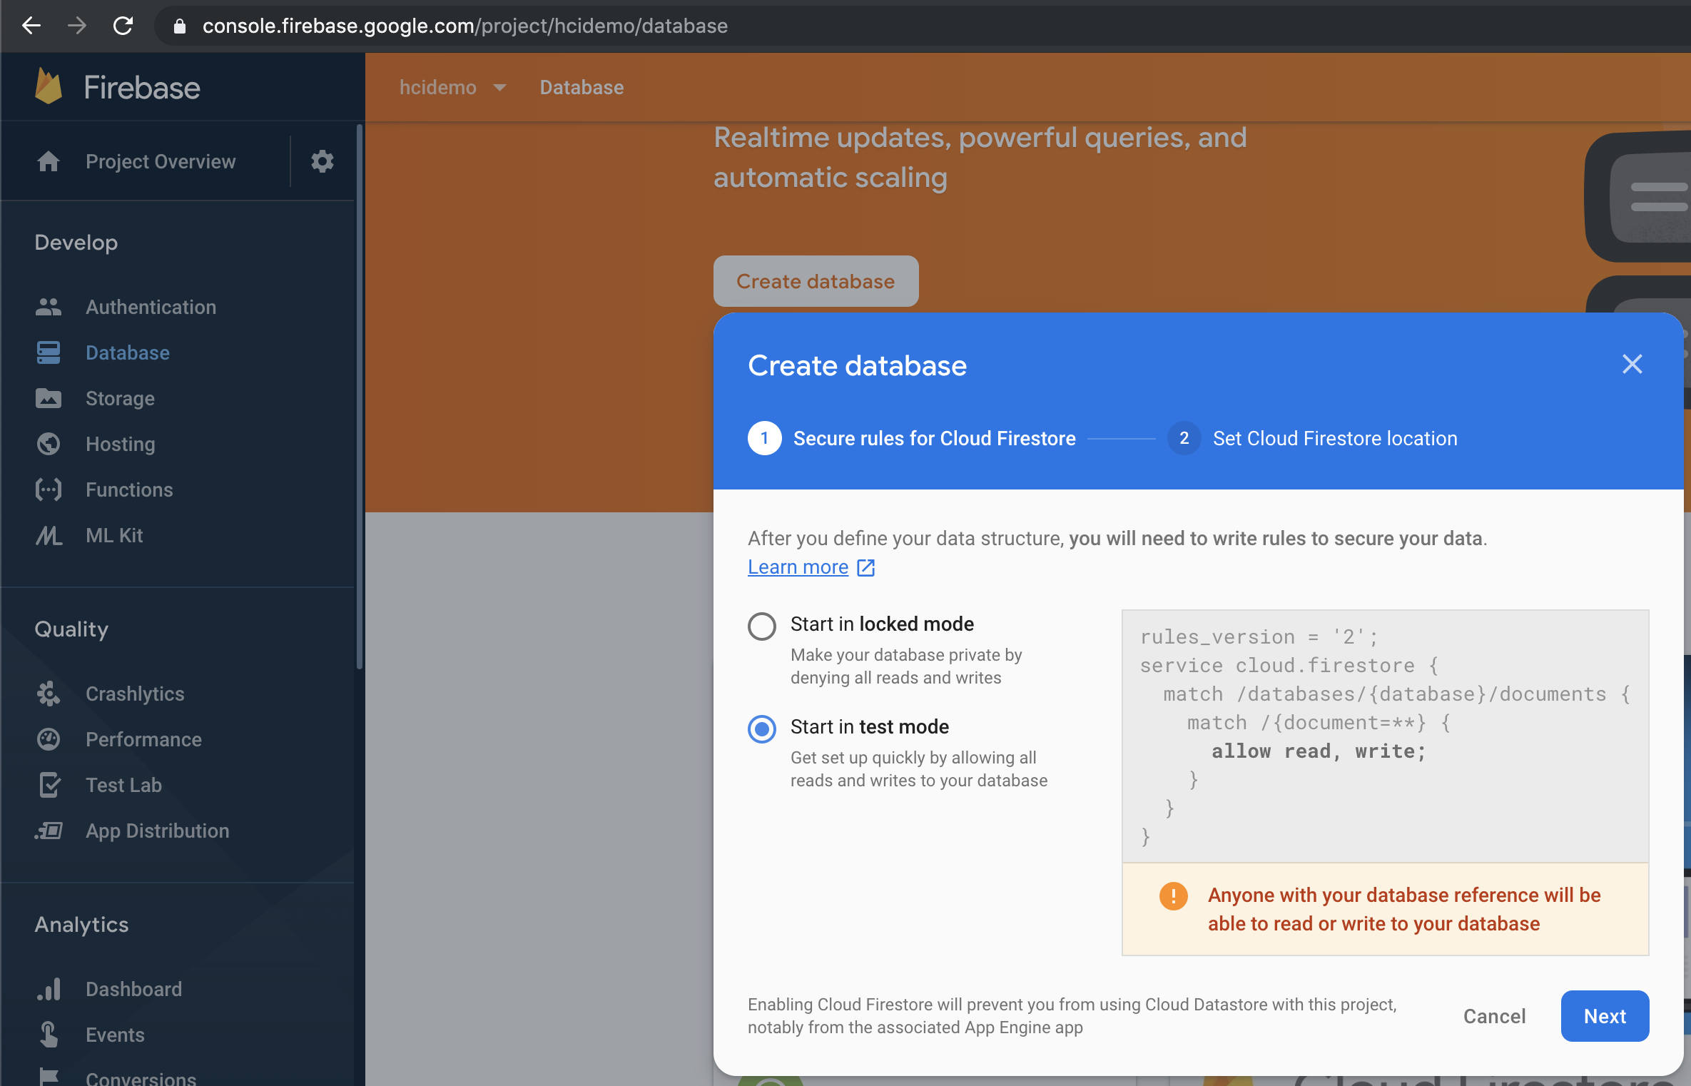
Create database

Slide 24
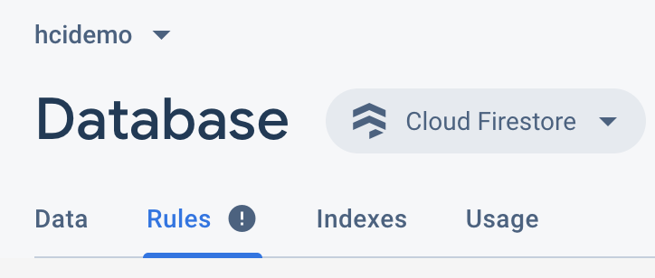
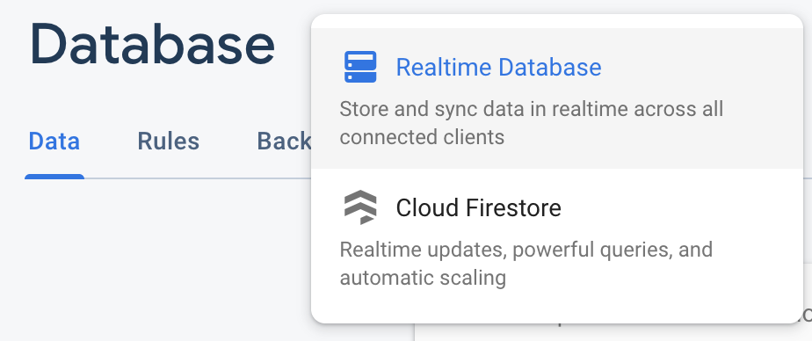
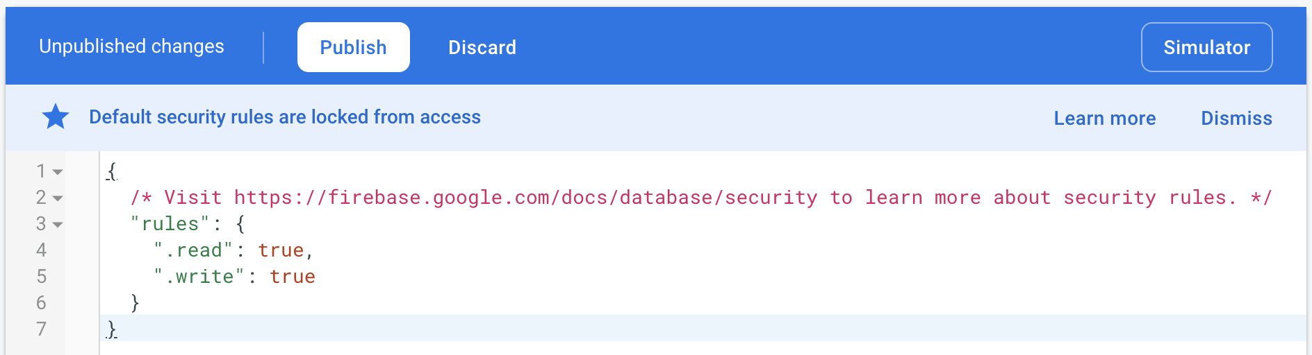
Set test rules for development purpose
Remember to choose Realtime Database
(Not the default Cloud Firestore)
Update these and publish
(allows all read/write)

Slide 25
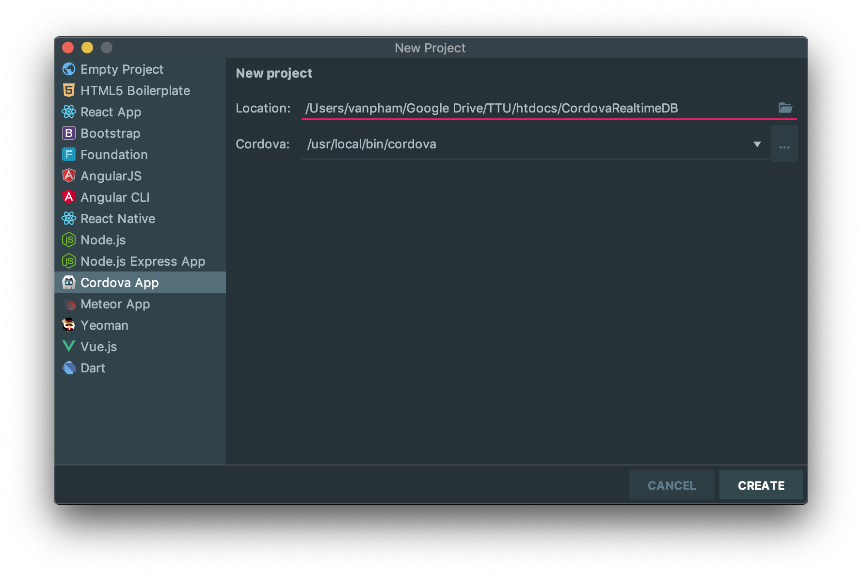
The CordovaRealtimeDB app
This should be the same app as your CordovaHealth, but we separate this to focus on one topic at a time.

Slide 26
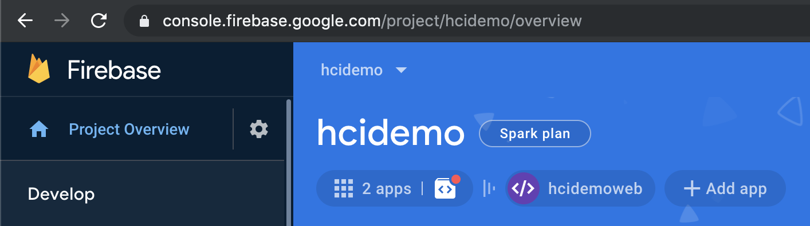
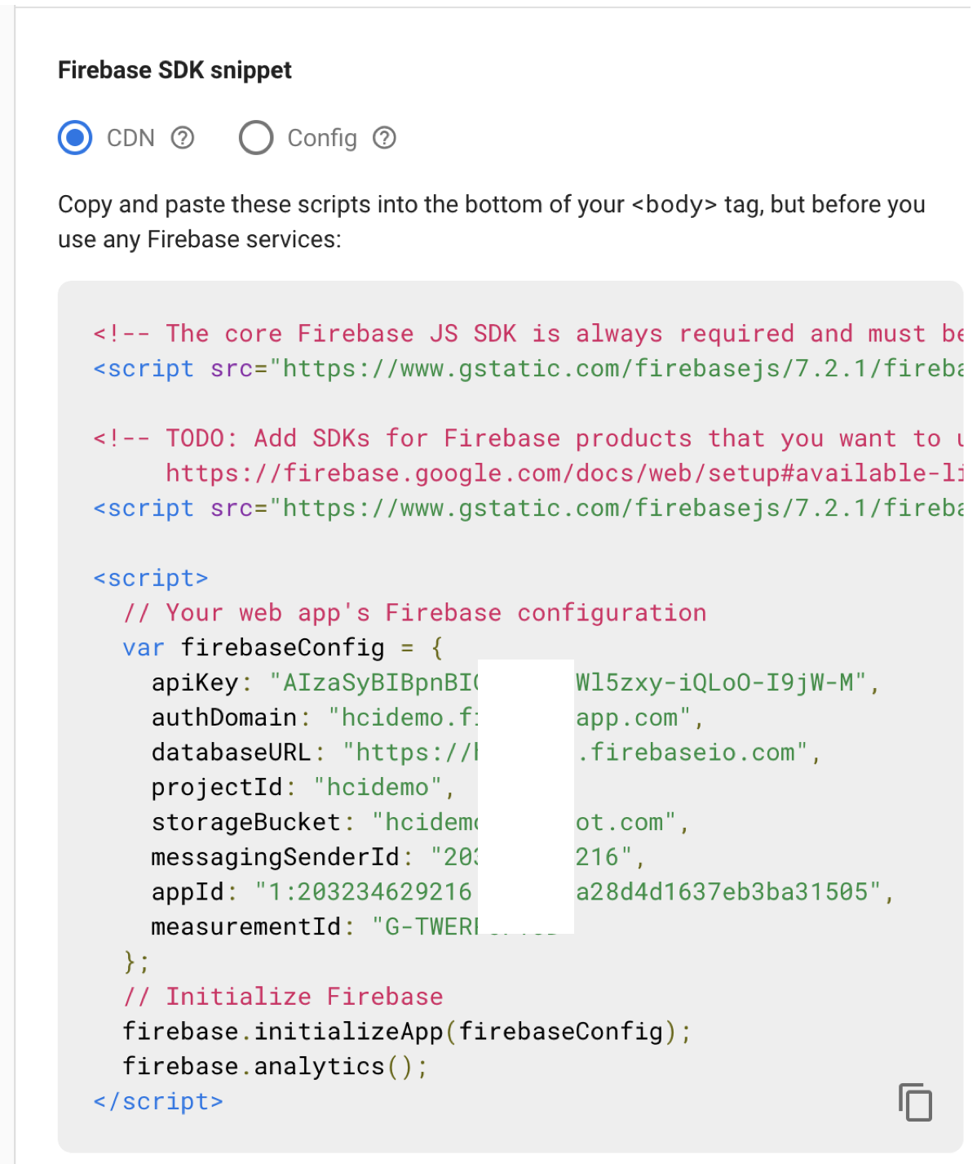

Setup web Firebase (https://firebase.google.com/docs/database/web/start)
Copy these
We don’t need these

Slide 27
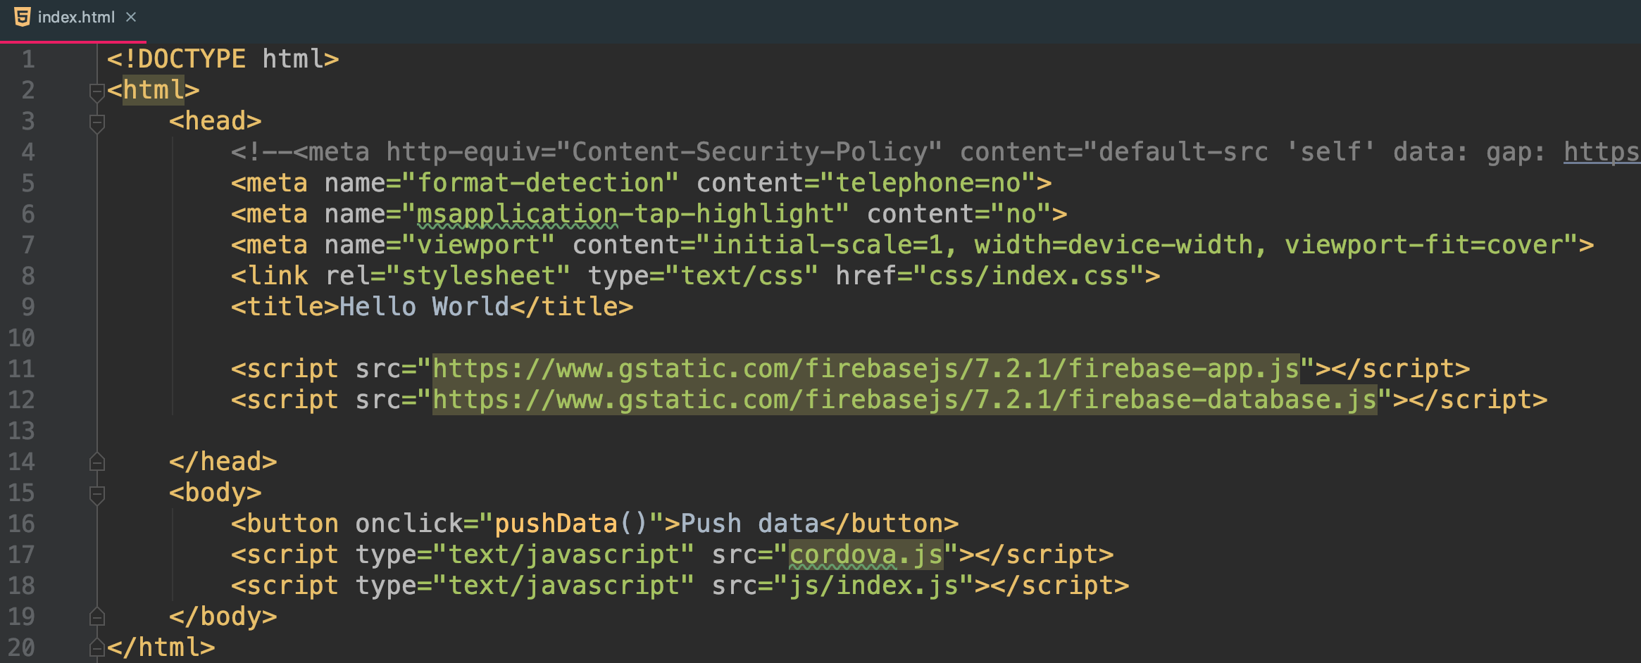
Update index.html
Comment this line to allow it to load external scripts for Firebase support
Also need this to support database operation.

Slide 28
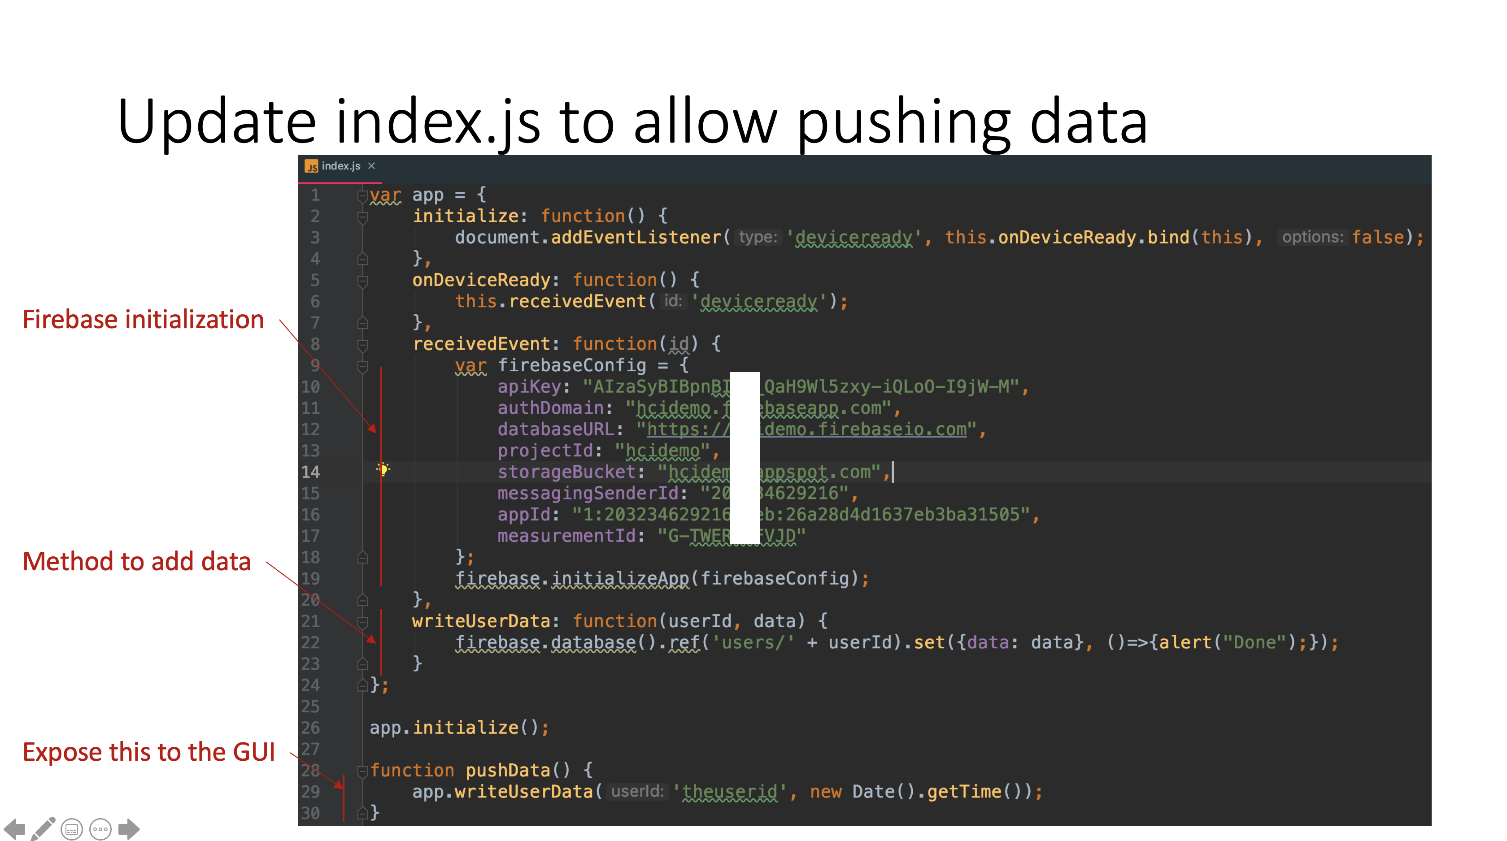

Slide 29
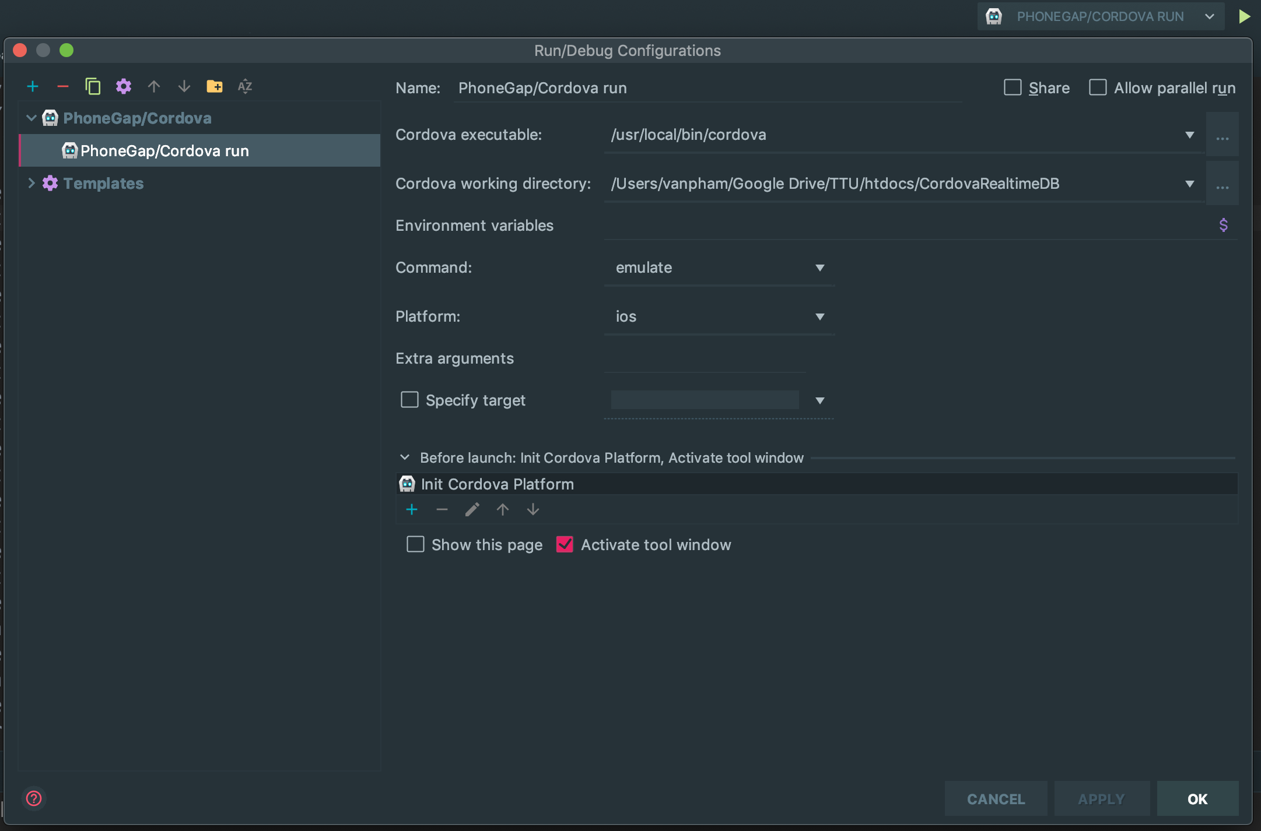
Emulate with iOS

Slide 30
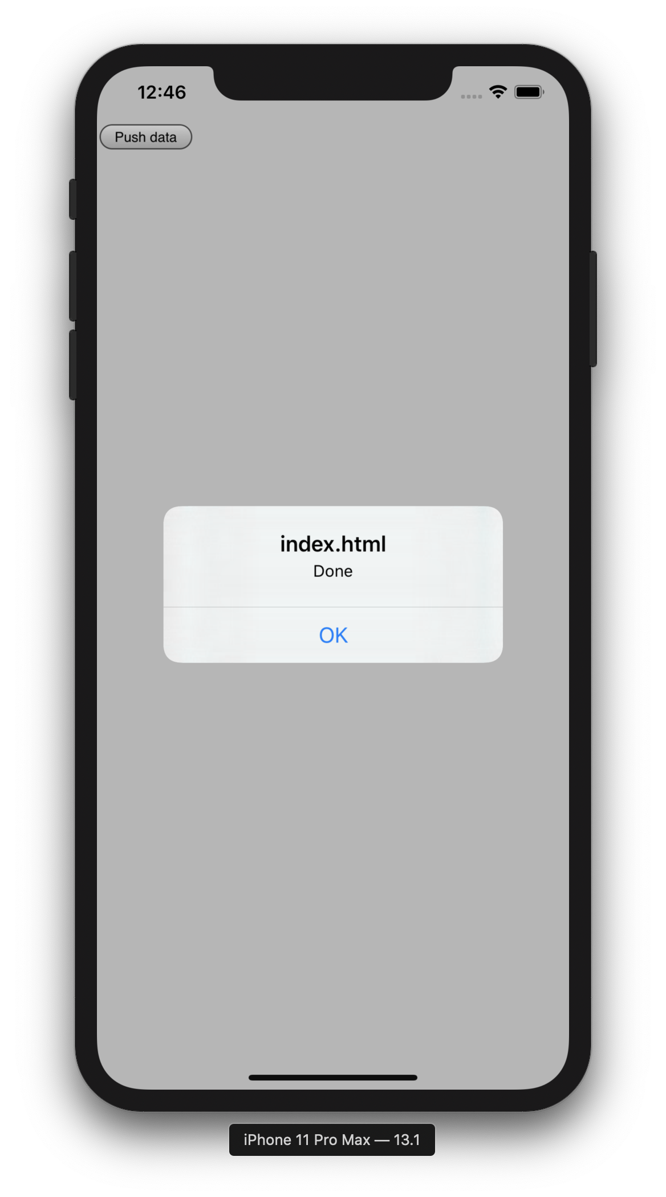
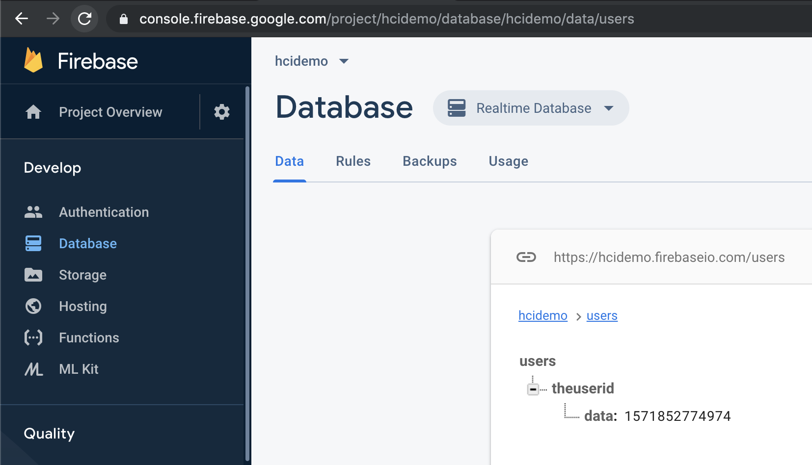
Test

Slide 31
Load the data to your mirror web app
Similar to the prev. cordova but this time it is setup for web application (not Cordova).
Please follow this reference:
https://firebase.google.com/docs/database/web/start

Slide 32
Next steps?
Change the database rule that only allows authenticated users (e.g., using Google, Twitter authentication) to read/write
Use push notifications (e.g., with Firebase) to support real-time synchronization

